Slide 1
Discussions on Client-side Query Processor
Yupeng Fu

Slide 2
Roadmap
Browser
Query
Server
Client-side Query Processor
Server-side Query processor
Server-side UAS
Client-side UAS
InMemory
JDBC
Application
InMemory
Persistent
Synchronize
Conflict Resolution

Slide 3
Where are we
A fully translated client-side query processor
Data model
UAS, in-memory data source
Query compiler
Query executor
XML parser, Test environment
Compilation Tutorial https://trac.forward.ucsd.edu/main/wiki/Development/GWT
Demo

Slide 4
The compiled JS
0.63 MB
Break-down
Performance

Slide 5
Client-side data storage
Goal
Persistent local storage to store large amounts of relational data
HTML5’s Local storage
Widely implemented by browsers
A simple JS API to store key-value pairs of string value
Useful for storing smaller amounts of data

Slide 6
Build it on top of IndexedDB
IndexedDB
Supported by FireFox, Chrome, IE10
Provides primitive Btree APIs
Key-Value-pairs store of JS object.
Build SQL++ API on IndexedDB
Scan, IndexScan
DML operators
Build IndexedDB on top of local storage?

Slide 7
IndexedDB-Databases
Each origin has a set of databases.
A database comprises one or more object stores.
Every database has a name.

Slide 8
IndexedDB-Object store
An object store has a list of records which hold data stored. The object store can only be changed using a VERSION_CHANGE transaction.
Each record consists of a key and a value. The list is sorted according to key in ascending order.

Slide 9
IndexedDB-Transaction
Transactions are opened in one of three modes.
READ_ONLY
READ_WRITE
VERSION_CHANGE

Slide 10
IndexedDB-Keys
Keys can be derived from three sources:
A key generator, which generates a monotonically increasing number every time a key is needed
Via a key path, a string that defines how to extract key from a value
Explicitly specified when a value is stored

Slide 11
IndexedDB-Keys- Example 1
If the following conditions are true:
This is the fourth entry in an object store.
The object store has a key generator.
There is no in-line value for the key path property.
Then the value provided by the key generator is used to populate the key value.
"foo.bar"
{ foo: {} }
"foo.bar"
{ foo: {bar=4} }

Slide 12
IndexedDB-Keys- Example 2
If the following conditions are true:
This is the fourth entry in an object store.
The object store has a key generator.
There is a value for the key path property.
Then the value associated with the key path property is used.
"foo.bar“
{ foo: { bar: 10 } }

Slide 13
IndexedDB-Index
An index is a specialized persistent key-value storage and has a referenced object store.
The records in an index are automatically populated whenever records in the referenced object store are inserted, updated or deleted.
If a given record with key X in the object store referenced by the index has the value A, and evaluating the index's key path on A yields the result Y, then the index will contain a record with key Y and value X.

Slide 14
IndexedDB-Key Range
Records can be retrieved from object stores and indexes using either keys or key ranges.
A key range is a continuous interval over some data type used for keys.
interface IDBKeyRange {
readonly attribute any lower;
readonly attribute any upper;
readonly attribute boolean lowerOpen;
readonly attribute boolean upperOpen;
static IDBKeyRange only (any value);
static IDBKeyRange lowerBound (any bound, optional boolean open);
static IDBKeyRange upperBound (any bound, optional boolean open);
};

Slide 15
IndexedDB-Cursor
A cursor comprises a range of records in either an index or an object store. The cursor
has a source that indicates which index or object store is associated with the records over which the cursor is iterating.
maintains a position over this series, which moves in a direction that is in either monotonically increasing or decreasing order of the record keys.
Has a key and a value which represent the key and the value of the last iterated record.
finally have a got value flag. When this flag is false, the cursor is either in the process of loading the next value or it has reached the end of its range

Slide 16
Build operators on IndexedDB
Scan
Enumerate the entire table using the cursor
Index Scan
Translate the predicates to the key range
Get the referenced range of records and iterate
DDL
Schema is stored as string
DML

Slide 17
Intertwine JavaScript and Java objects
GWT's JavaScript Native Interface (JSNI)
Writing Java methods with JavaScript
Calling Java methods from JSNI
Access external JavaScript code
public class Flipper {
public native void flipName(String name) /*-{
var re = /(\w+)\s(\w+)/;
var s = name.replace(re, '$2, $1');
this.@org.example.foo.Flipper::onFlip(Ljava/lang/String;)(s);
}-*/;
private void onFlip(String flippedName) {
// do something useful with the flipped name
}
}
<html>
<head>
<script>
function sayHello(name) {
alert("Hello from JavaScript, " + name);
}
</script>
...
// A Java method using JSNI
native void sayHelloInJava(String name) /*-{
$wnd.sayHello(name); // $wnd is a JSNI synonym for 'window'
}-*/;
// Java method declaration...
native String flipName(String name) /*-{
// ...implemented with JavaScript
var re = /(\w+)\s(\w+)/;
return name.replace(re, '$2, $1');
}-*/;

Slide 18
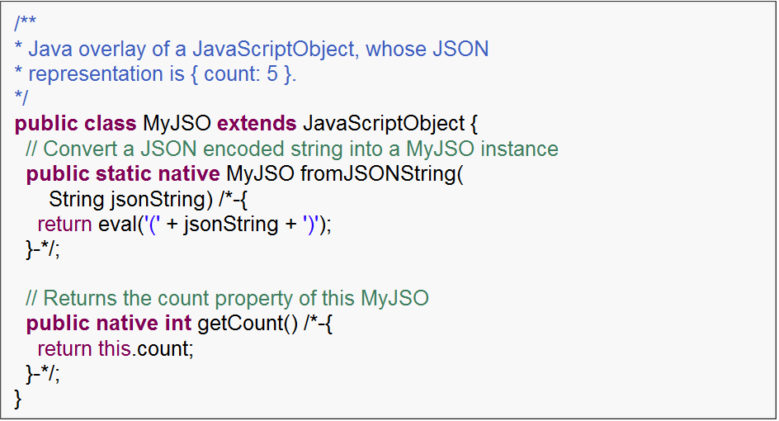
Intertwine JavaScript and Java objects
JavaScript overlay types
Interact directly with JavaScript objects from Java source code.
JS objects that look like Java objects when coding but with zero-overhead

Slide 19
Get the work done distributely!
How to transfer data (and query plan)?
XML serialization.
Slow! 150-tuples transfer done in 10second
GWT’s RPC support.
The data model must be serializable
JSON
Conversion between JSON and our data model

Slide 20
Get the work done distributely!
How to compile the query and optimize?
The client-side must have the serve-side UAS’s schema to compile
Run the plan locally or at the remote server?
If a plan involves data both on client and server, send the data from client to server or the other way

Slide 21
Get the work done distributely!
How to execute the query?
Client-side implementation of sendPlan operator
Achieve the synchronous behavior with asynchronous API
How to invoke the server-side query processor, security concern
How to execute the apply operator
Send a batch of parameters to save bandwidth

